Slide 1
secure data hiding in images using steganography
CAPSTONE PROJECT
Presented By: Ankitha R
Student Name : Ankitha R
College Name : Bapuji Institute of Engineering and Technology
Department : Electronics and Communication Engineering

Slide 2
OUTLINE
Problem Statement
Technology used
Wow factor
End users
Result
Conclusion
Git-hub Link
Future scope

Slide 3
Problem Statement
Developing a Python-based steganography system for seamless data embedding and extraction.
Ensuring confidential data transmission by embedding sensitive information within images using steganography techniques.
Preventing unauthorized access and detection by applying advanced encryption and encoding methods.
Maintaining image quality while maximizing data hiding capacity for secure communication.

Slide 4
Technology used
Python – The core programming language used for implementing the steganography technique. (IDLE terminal)
Tkinter: Python's standard GUI library for creating the user interface (buttons, labels, input fields, etc.).
3. OpenCV (cv2): Used for image processing tasks like reading, modifying, and saving images.
4. Steganography: The technique of hiding secret messages within an image by modifying pixel values.
5. SHA-256 Hashing: A cryptographic hash function used to securely hash passwords for authentication.
6. File Handling: Used to load and save image files (cv2.imread, cv2.imwrite).
7. OS Module: Used to execute system commands (e.g., opening the encrypted image with os.system).
8. Message Encoding/Decoding: ASCII-based encoding and decoding of characters for embedding and extracting messages.
9. Error Handling: Ensures the program handles errors gracefully (e.g., invalid image paths, incorrect passwords).
10. Cross-Platform Compatibility: The program can run on any operating system (Windows, macOS, Linux) with Python installed.

Slide 5
Wow factors
Dynamic Pixel Encoding – Instead of using fixed patterns, the message is spread dynamically across different pixel channels, enhancing security.
Passcode-Based Decryption – Unlike basic LSB steganography, this project adds an authentication layer, ensuring that only authorized users can extract the hidden message.
Lightweight and Fast Execution – Uses minimal dependencies (OpenCV and Python) for quick encryption and decryption without requiring complex cryptographic algorithms.

Slide 6
End users
Cybersecurity Enthusiasts – Exploring data hiding and secure communication.
Journalists & Whistleblowers – Safely embedding and transmitting sensitive information.
Students & Educators – Learning steganography in cybersecurity and image processing.
Forensic Experts – Detecting hidden messages in cybercrime investigations.
Privacy-Conscious Users – Secure communication without attracting attention.
Military & Intelligence – Covert communication for classified information.

Slide 7
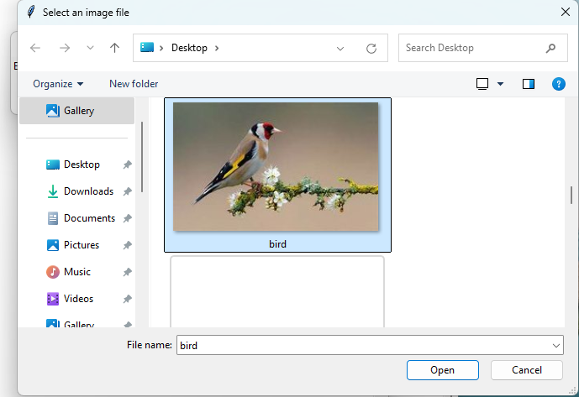
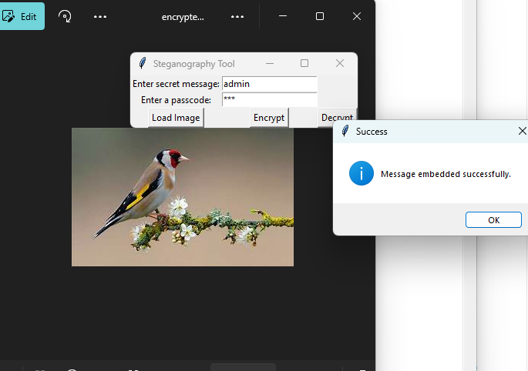
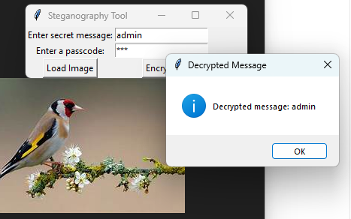
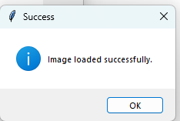
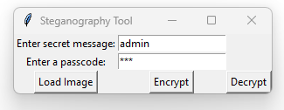
Results

Slide 8
Conclusion
1. Effective Steganography Tool:
- The program successfully hides and retrieves secret messages within images using pixel manipulation.
2. Secure Password Protection:
- SHA-256 hashing ensures that only authorized users can decrypt the hidden message.
3. User-Friendly Interface:
- The Tkinter-based GUI makes the tool easy to use for encryption and decryption tasks.
4. Versatile and Portable:
- The program is lightweight, cross-platform, and can handle various image formats for steganography.

Slide 9
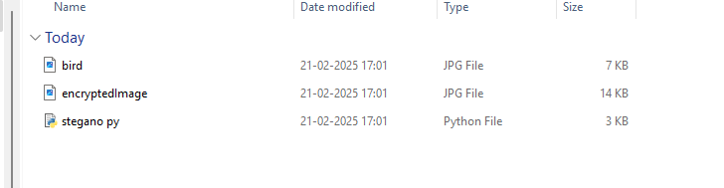
GitHub Link
https://github.com/ankitharamesha/stegano-py.git

Slide 10
Future scope(optional)
1. Advanced Security:
- Add stronger encryption (e.g., AES) and AI-based techniques to enhance data protection and resist detection.
2. Multi-Media Support:
- Extend the program to hide data in audio, video, and documents, not just images.
3. Cloud and Mobile Integration:
- Enable cloud storage support and develop mobile apps for easy access and sharing.
4. Improved User Experience:
- Upgrade the interface, add batch processing, and allow customizable security levels for better usability.

Slide 11
THANK YOU

